Slide 1


Department of Electrical and Electronics Engineering Academic year 2024-2025(Even Semester) II year/III Semester EEB1233 - DESIGN THINKING LABORATORY Project Review
TANK WATER LEVEL ALARM WITH IOT
BATCH NUMBER : 11
DATE : 07 / 05 / 2025
S. VIKRAM (927623BEE120)
R .VIKRAM (927623BEE119)
VIJAYPRASANA . B (927623BEE117)
VIKNESHWARAN . A (927623BEE118)
VIGNESHWARAN . S (927623BEE116)

Slide 2
Abstract
Water wastage due to overflow and dry running of motors is a common problem in households and industries. Manually monitoring water levels can be difficult, especially for elderly users. This project presents a simple and cost-effective water level monitoring system that allows users to switch the motor ON/OFF using a mobile keypad.
The system consists of water level sensors that detect water levels and provide alerts when the tank is full or empty. By integrating a remote motor control feature, this system eliminates the need for physical effort and ensures efficient water management.

Slide 3
Objective
To develop an automatic water level monitoring system to reduce human intervention.
To enable mobile keypad-based remote motor control, making it convenient for elderly users.
To prevent overflow and dry running of the motor, saving water and electricity.
To design a low-cost and easy-to-install system for households and industries

Slide 4
Proposed idea
The idea of this project is to make a water tank system that can alert people when the water is full or empty and also allow them to turn the motor ON or OFF indicator using a basic mobile phone keypad.
After gathering all the things required you`ll need to first open the remote of the bell from the back side and install the cell in my case it is of 12Volt and 23amp cell and after installing cell in remote you will need to install 1.5V AA cells in receiver and after installation of cells check the bell it should work properly and also test the range it should be according to your need.
This system is very helpful for old-age people who cannot walk often to check the tank or press wall switches. With the help of simple sensors and a control setup, the motor can be easily operated from anywhere nearby using just a phone.

Slide 5
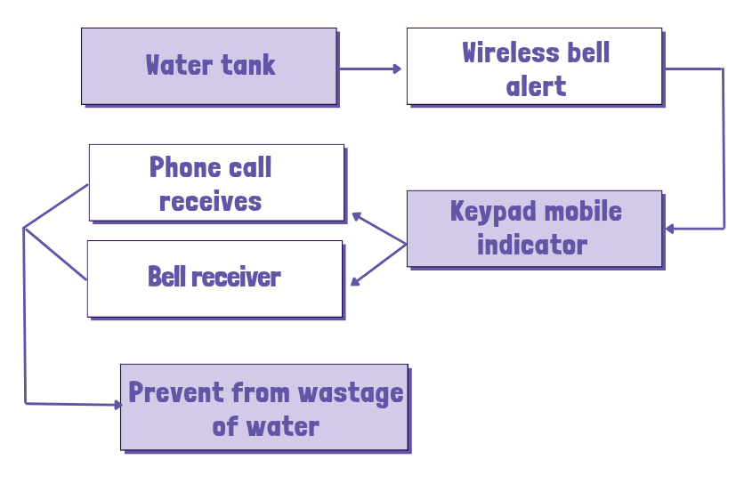
Block diagram

Slide 6
Components
Water Level Float Sensors
Detects Full water levels.
Sends signals to the control circuit to trigger motor operation.
Bell Indicator
Alerts users when the tank is full.
Provides visual feedback on system operation.
Mobile Keypad Control
Allows users to turn the motor ON/OFF manualy observing using a simple mobile phone.
Uses the need for manual switches that helps to reduce waste water .

Slide 7
Working
Water level detect Full levels and send signals to the control circuit as in the calling bell.
When the tank is full, the system activates an alarm and an LED indicator.
Users can turn off manualy using a mobile keypad, reducing the overflow of water
The system automatically stops the motor when the tank is full to prevent wastage.

Slide 8
Result
The Tank Water Level Alarm with IoT system was successfully designed and implemented using a float sensor and a wireless bell unit. Upon testing, the float sensor accurately detected the high water level in the tank. When the water reached the preset level, it triggered the wireless bell remote, which in turn sent a signal to the indoor bell receiver. The bell rang promptly, providing an audible alert that the tank was full. The system worked reliably within the wireless range and required minimal power, making it a cost-effective and user-friendly solution for household water monitoring.

Slide 9
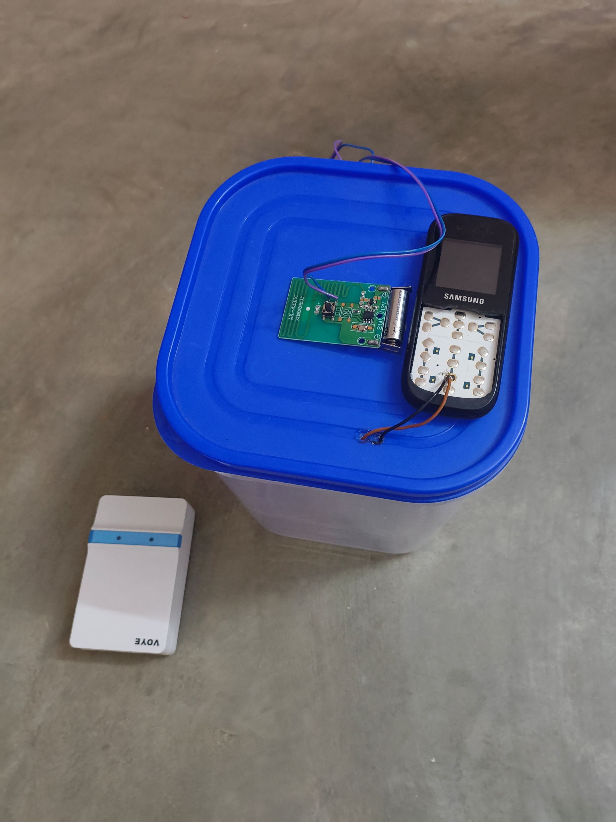
Kit picture

Slide 10
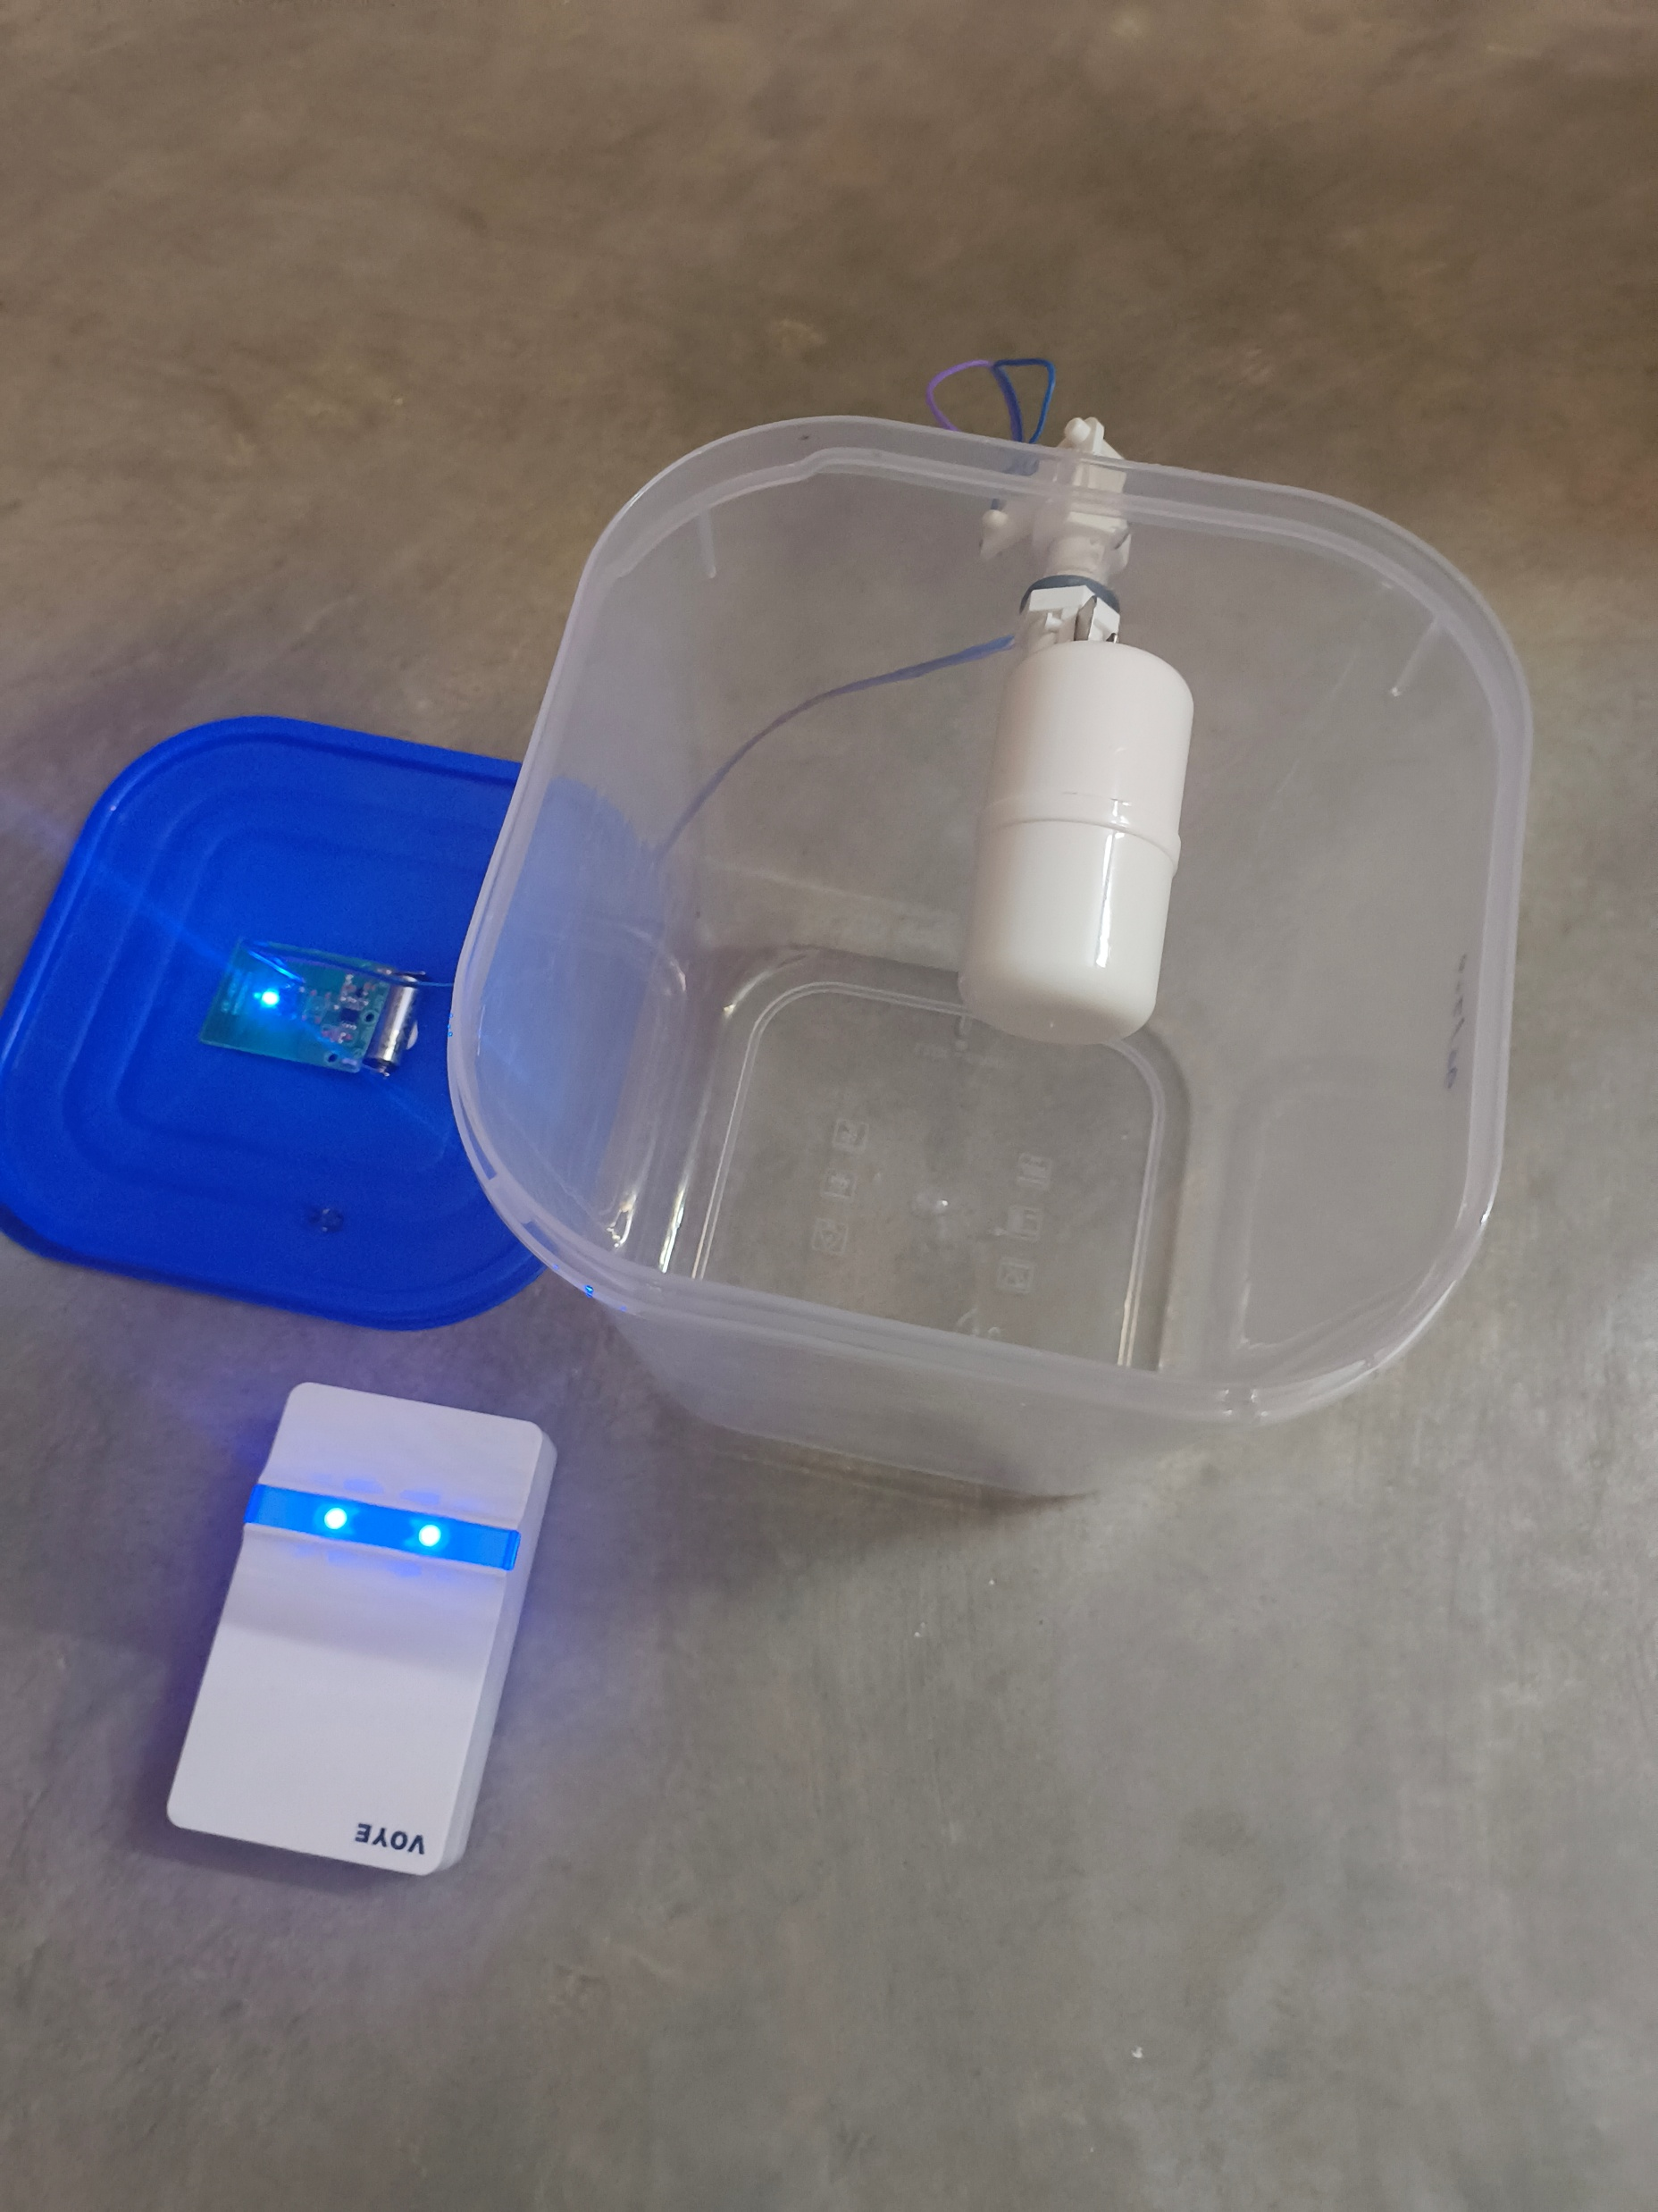
Demo pictures

Slide 11
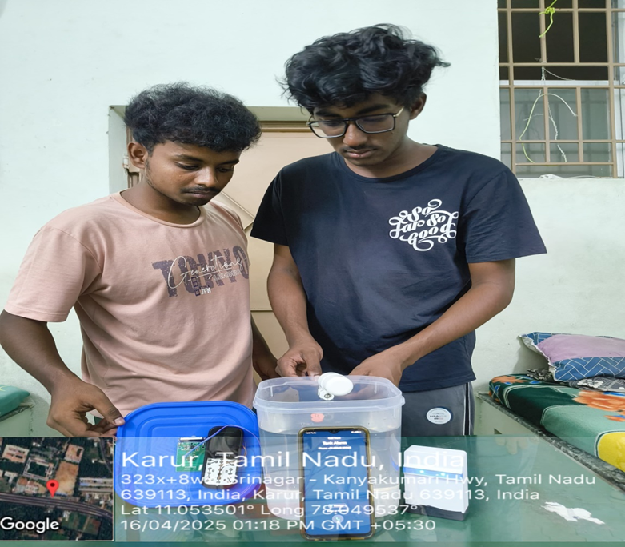
Feedback and Demo picture
ROLE : Customer feedback
I can now operate the pump from my mobile while working in the field.
This device saved my crops from drying due to empty tanks.
It works well with simple components low maintenance.
The cost is affordable, and I didn’t need to hire a technician.

Slide 12
Conclusion
The IoT-based tank water level alarm system efficiently monitors water levels and prevents overflow or shortages. It provides real-time alerts through a mobile app or web dashboard, reducing manual effort. The system helps in water conservation and ensures better resource management .With automation, it can also control water pumps, making it ideal for homes, industries, and agriculture.This smart solution improves efficiency, saves water, and simplifies monitoring.

